Slide 1
Multi-class Classifications of Malicious URLs using Deep Learning
University of Toronto School of Continuing Studies
SCS 3546 Deep Learning

Slide 2
Introduction
Artificial Intelligence (AI) and cybersecurity are two of the most rapidly growing sectors in the technology industry. The global AI in cybersecurity market was valued at $19.2 billion in 2022, and is projected to reach $154.8 billion by 2032, growing at a CAGR of 23.6% from 2023 to 2032.¹ The future growth of both AI and cybersecurity is promising and will be critical in the future.
¹ https://www.alliedmarketresearch.com/ai-in-cybersecurity-market-A185408

Slide 3
Objective
Dataset
This study will explore a lightweight approach to identify and classify malicious URL using deep learning via Keras.
University of New Brunswick Canadian Institute for Cybersecurity URL dataset (ISCX-URL2016) https://www.unb.ca/cic/datasets/url-2016.html

Slide 4




Dataset
This study reused UrlDatasetLoader ² from the ML project to conduct data cleaning and preparation which includes handling Null and NaN values, feature selections and anomaly detection.
The prepared dataset is then exported to CSV files and uploaded to Deep Learning Git repository for use in training.
X_train, y_train
SCS 3253 Machine Learning
X_test, y_test
SCS 3546 Deep Learning
² https://nbviewer.org/github/quickheaven/scs-3253-machine-learning/blob/977a523a096097b350ec78cfcfc7357142e0fe1e/loader_nb.ipynb
Icons made from <a href="https://www.onlinewebfonts.com/icon">svg icons</a>is licensed by CC BY 4.0

Slide 5

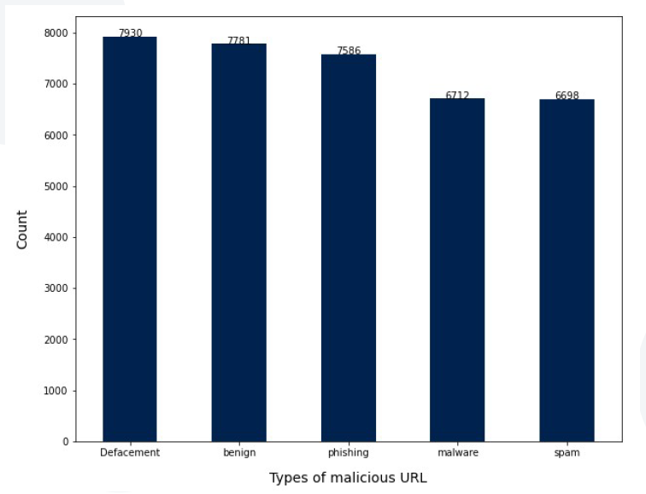
Dataset
The five different types of malicious URLs
Defacement
Benign
Phishing
Malware
Spam
https://quickheaven.github.io/scs-3253-machine-learning/

Slide 6
Training and Tuning Model
Tuning Deep Neural Network
Tuning Back Propagation
Overfitting Management
Epoch and Batch size tuning
Hidden layers tuning
Determining nodes in a layers
Choosing Activation Function
Initialize Weights
Batch Normalization
Optimizers
Learning Rates
Regularization
Dropout

Slide 7
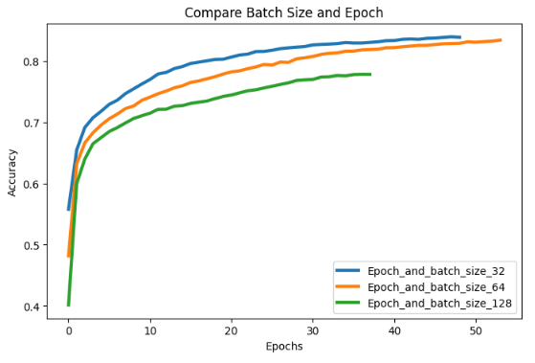
Tuning Deep Neural Network
Epoch and Batch size tuning
Figure out the right number of batches and epochs first, and then use that for further experimentation.
Batch Size: Experiment for the right size, batch size of 32 found most optimal for most use cases.
Epoch: Choose the earliest value when accuracy stabilizers.
The model with batch size 32 result to higher accuracy and faster completion with fewer epochs.

Slide 8
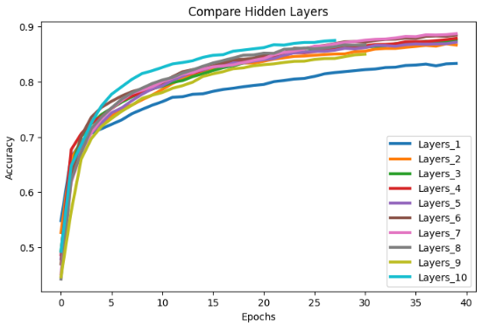
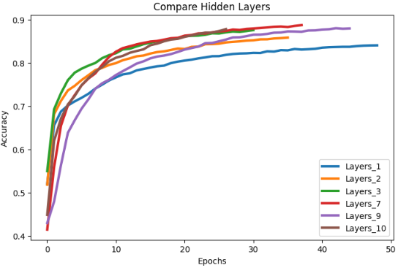
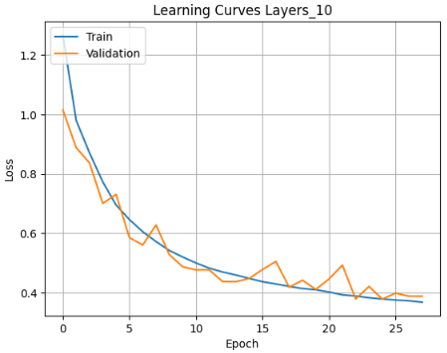
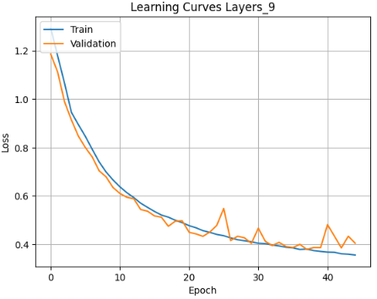
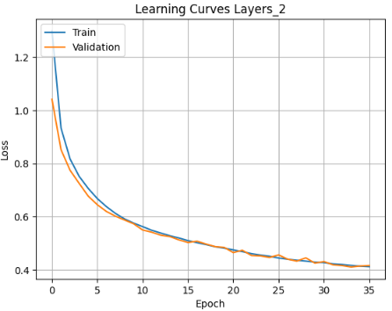

Tuning Deep Neural Network
Hidden layers tuning
One of the key model architecture hyperparameters is the number of hidden layers. As the number of layers increases, it increases the possibility of learning complex relationships between features and target variables, but it will also increase the cost and time needed for both training and inference. It is also has the risk of overfitting the training set. A value of two has been sufficient for simple problems. It is recommended to increase the number of layers only based on experimentation if the set accuracy levels are not achieved. Otherwise, additional layers will take resources and time without providing any additional value.

Slide 9
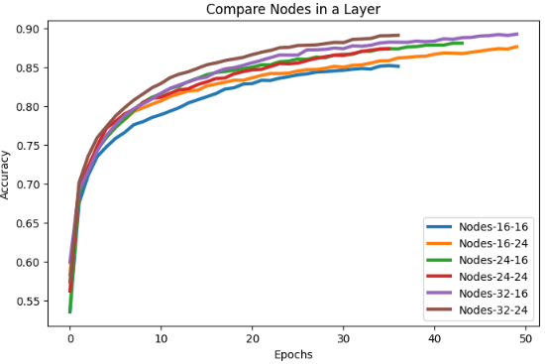
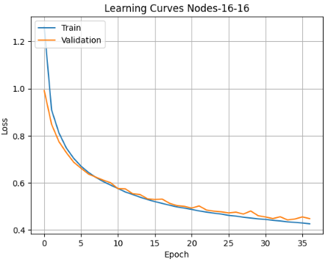
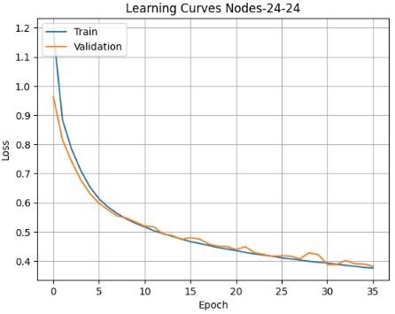
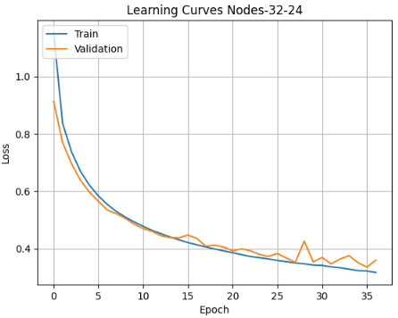
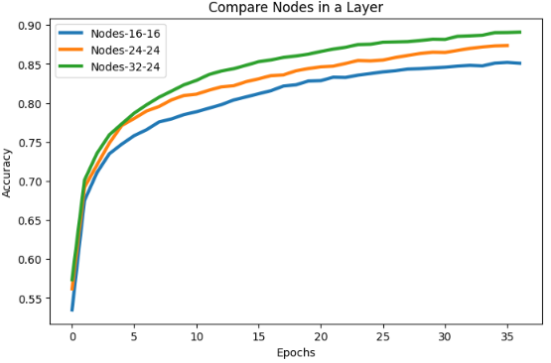
Tuning Deep Neural Network
Determining nodes in a layers
More nodes means more possibility for the model to learn complex relationships. However similar to number of layers, it will results to more training and resources.

Slide 10
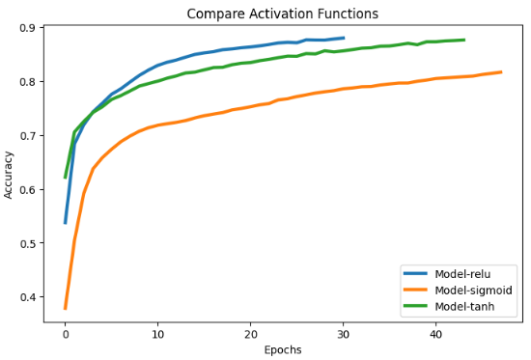
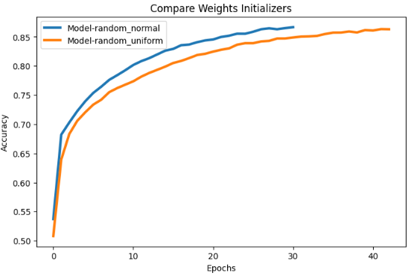
Tuning Back Propagation
Choosing Activation Function and Weights Initializer
There are number of algorithms available for activation functions. In general, rectified linear unit works best for regular artificial neural network (ANN) and convolutional network (CNN). Sigmoid works best for RNNs.
The initial values of weights play a huge role in the speed of learning and final accuracy. Multiple initialization techniques exist. Random normal works best for most cases.
relu
random_normal

Slide 11
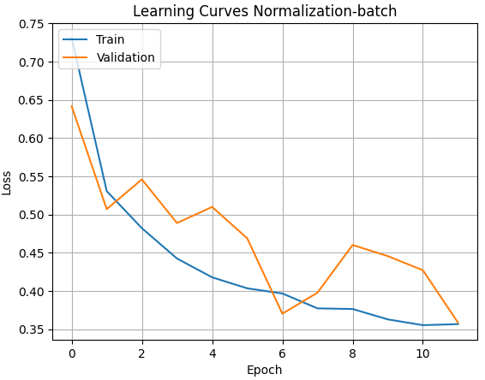
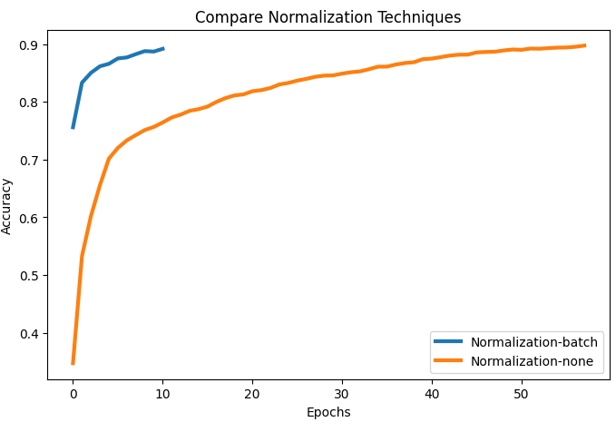
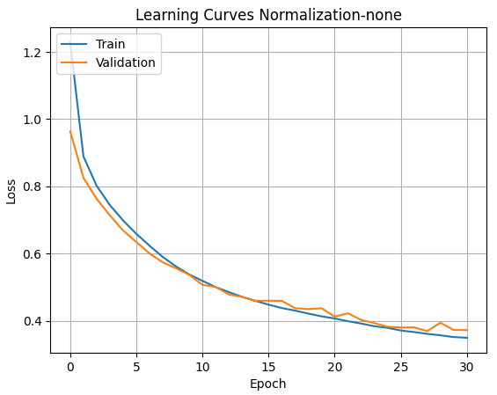
Tuning Back Propagation
Batch Normalization
Batch normalization is an important technique to vanishing and exploiting gradients during gradient descent. Batch normalization help achieve higher accuracies with lower epochs, hence is also an optimization technique.

Slide 12
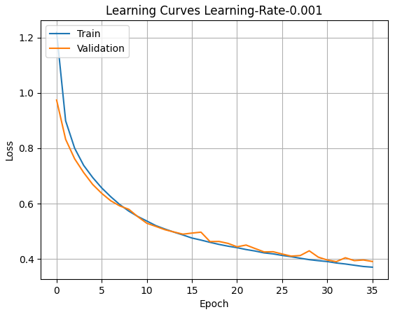
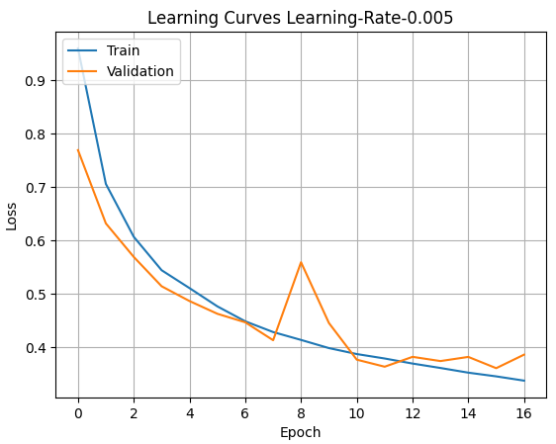
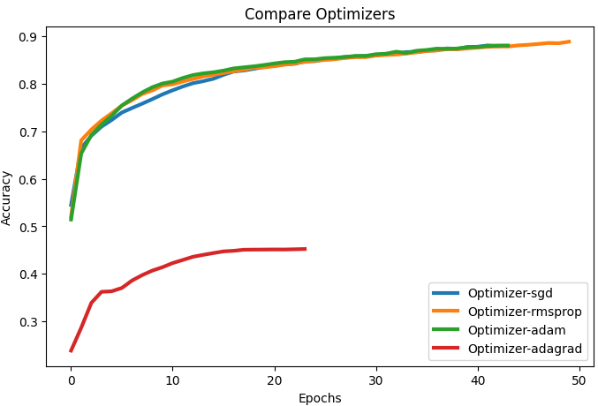
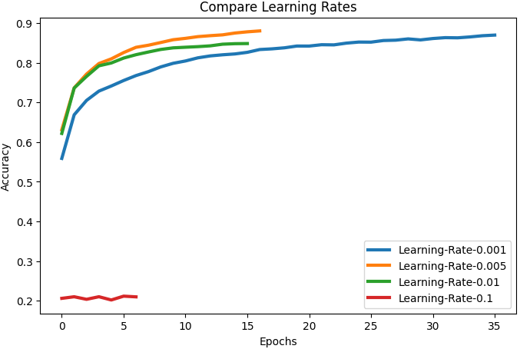
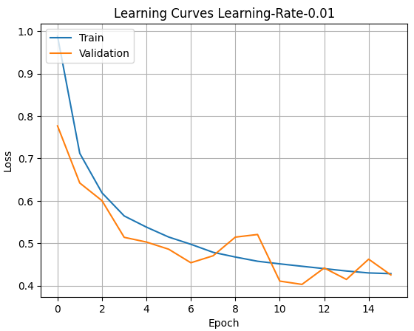
Tuning Back Propagation
Optimizers and Learning Rates
Learning rate is the rate at which the weights will change in response to the estimated error. It is the speed at which the model is expected to learn from the training data and adjust its weights. Learning rates work in conjunction with the optimizer.
Optimizer are key tools, that help gradient descent, achieve faster results. Optimizers are algorithms, that helps speed up the training process.

Slide 13
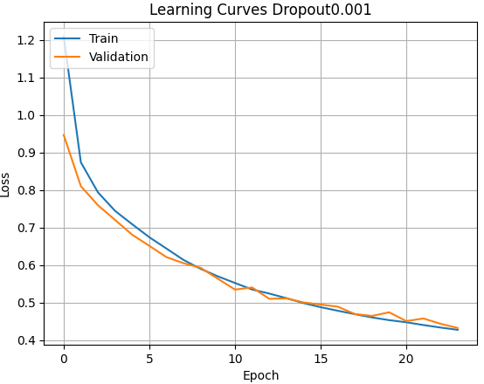
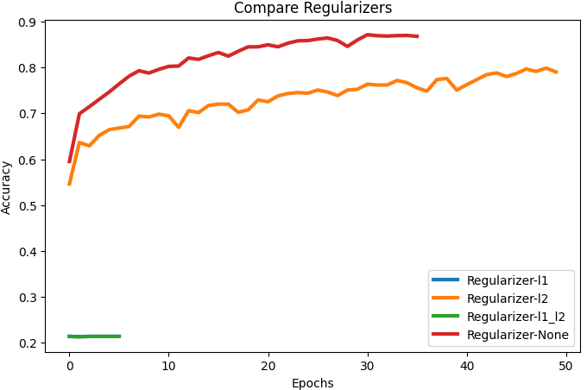
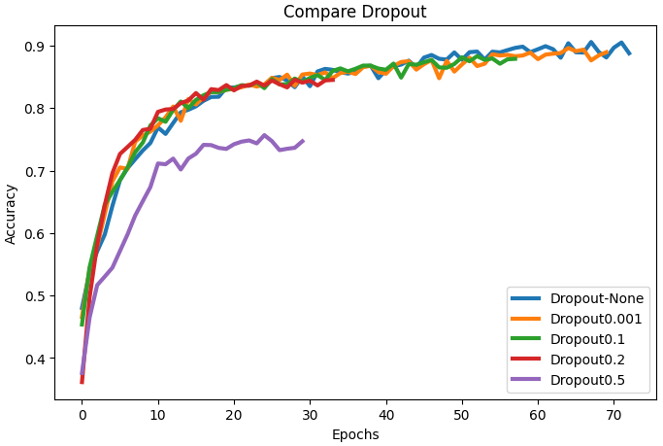
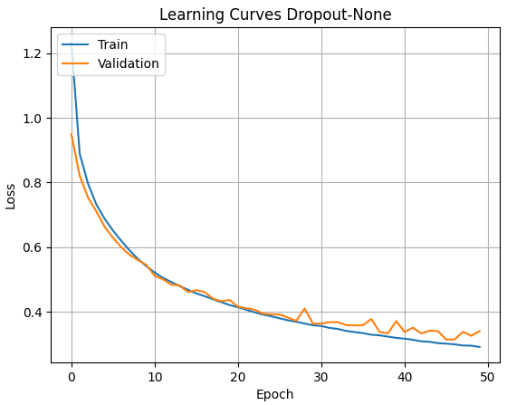
Overfitting Management
Regularization and Dropout rate
Regularization is an important technique for managing overfitting in neural networks. Regularization algorithms provide an adjustments to the model parameters after they are updated. The adjustment reduces the variance in the model by providing a penalty when overfitting.
Dropout works during forward propagation. By default, during forward propagation, the output of each node in the layer is sent every node in the next layer. When using dropout, the outputs of some of the nodes in the layer are dropped randomly.

Slide 14
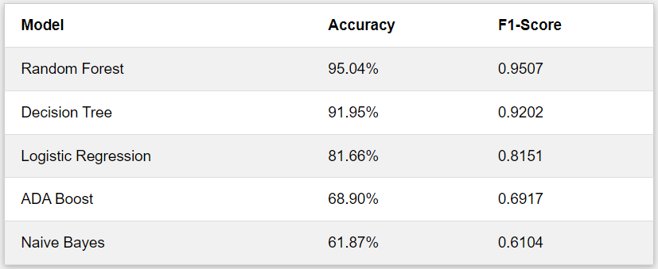
Model Evaluation
88%
Tuning Deep Neural Network
Epoch and Batch size tuning: 50 epochs / 32 batch
Hidden layers Tuning: 2 layers
Nodes in a layer: 24-24 nodes each layer
Activation Function: relu
Weight Initializer: random_normal
F1-Score: 0.8860 Deep Learning (Keras)
Tuning Back Propagation
Batch Normalization: none
Optimizers: adam
Learning rates: 0.001
Overfitting Management
SCS 3253 Machine Learning
Regularization: none
Dropout rates: 0.001
The study also conducted additional experiments by adding more layers and increasing the number of nodes and it results to higher accuracy but shows signs of overfitting and instability on the model. The experiment with 3 hidden layers with 128-128-64 nodes ³ even results to 94% accuracy. Meanwhile, adding more layers on top of the three hidden layers shows no improvement and even deteriorates the accuracy.
³ https://github.com/quickheaven/scs-3546-deep-learning/blob/main/Project_Experiment_Cycle2_3Layers.ipynb

Slide 15
Conclusion
This study was able to prove that we can use Deep Learning via Keras to perform multiclass classification to identify the malicious URLs. It was also able to produce a model that has a good balance between accuracy and stability.
However, using Random Forest (RF) proves a better choice for this particular use case.⁴
⁴ A similar study conducted at the University of Southern California reached a similar conclusion.
Towards Detecting and Classifying Malicious URLs Using Deep Learning
https://isyou.info/jowua/papers/jowua-v11n4-3.pdf

Slide 16

Thank you!
Arjie Cristobal https://www.linkedin.com/in/quickheaven

